Slide 1








ActivitySim Tutorial
TRB Planning Applications Conference
Portland, OR
June 1, 2019
Notes:
JOE

Slide 2
What is ActivitySim?
Notes:
JOE

Slide 3
ActivitySim Project Goals & Principles
Goals
Principles
Create an activity-based travel model platform
Unify best practices
Reduce development costs
Reduce maintenance costs
Collaborate
Open Source
User-friendly
Documented
Stable
Extensible / Flexible
Optimized
Notes:
JOE

Slide 4
ActivitySim Approach
Create agency partnership
Design based on an existing best practice model
(MTC’s CT-RAMP)
Implement in Python using best software development practices and popular data science libraries (pandas, numpy)
Facilitate extensibility through modular design
Continuously integrate and test
Document comprehensively
Notes:
JOE

Slide 5
Agency Partnership
AMPO-led
All agency partners participate in decision making
Project Management Committee (PMC) sets annual development priorities
Pooled funding
New agencies are welcome
6 years of successful collaboration

Slide 6
Activity-Based Models
Predict demand for travel
  Types and amounts of activities
  Destinations
  Travel modes
  Timing
Inputs
  Synthetic population
  Employment and land use
  Network performance (travel times, costs, transfers, etc)
  Behavioral assumptions
Mostly discrete choice model components
Disaggregate
Monte Carlo simulation
Notes:
JOE

Slide 7
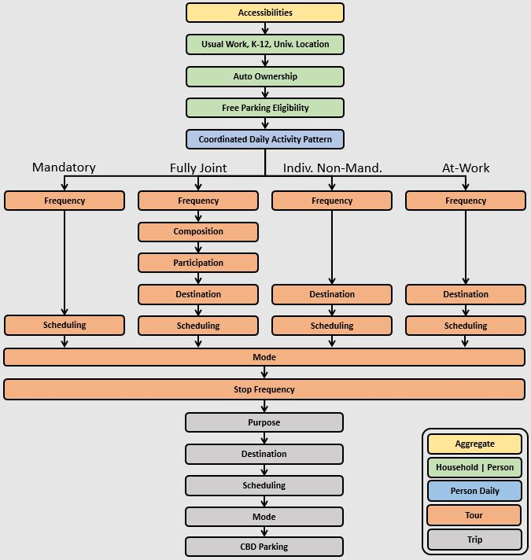
Structure & Components
Accessibilities
Work and school location
Auto ownership and parking
Daily activity patterns (intra-HH)
Individual tours, joint tours, and stops by activity purpose
  Frequency
  Composition
  Participation
  Scheduling
Tour and trip destination choice
Tour and trip mode choice
Notes:
JOE

Slide 8
Features of Initial Implementation (MTC)
Detailed activity purposes
  Work
  School (grade, high, university)
  Shopping
  Social / recreational
  Escorting
  Eat out
  Other maintenance
  Other discretionary
Temporal resolution
  1 hour
Modes
  SOV (free, pay)
  HOV2 (free, pay)
  HOV3+ (free, pay)
  Walk
  Bike
  Local Bus (walk / drive access)
  Light-Rail (walk / drive access)
  Express Bus (walk / drive access)
  Bus Rapid Transit (walk / drive access)
  Heavy Rail (walk / drive access)
Spatial resolution
  TAZs
  MAZs (in development)
Notes:
JOE

Slide 9
Features of Platform
Utilities
  Expressed as user configurable pandas Python expressions
Multiprocessing
  Configuration flexibility
Pipelining
  Model can be started / stopped at any point (with stable random numbers)
Tracing & Logging
  All calculations traced to CSVs for tagged households and ODs
Shadow pricing
Notes:
BEN

Slide 10
Data Requirements
Works with open data formats
Table Data in CSV or binary HDF5 format
  Zone data (households, employment by type, parking costs, etc.)
  Synthetic households
  Synthetic persons
Network LOS skims in open matrix (OMX) format
  By mode and time-of-day
Notes:
BEN

Slide 11
Implementation Requirements
Runs under Windows, Linux, or Mac
Size of problem drives requirements
  Population
  Number of zones, number of skims
Processes everything in RAM
  Makes use of chunking to process the population in manageable chunks of in-memory data
Is parallelized so more resources means faster runtimes
  More cores
  More memory
Notes:
BEN

Slide 12
Current Runtime Performance
Full scale example
  7.5 million people, 1450 zones, 825 network skims
  Process chunks of households in parallel using Python’s multiprocessing library
Windows Server
  Intel Xeon E5 2.6GHz 28 core 224GB RAM
  Single process setup runs in 24 hours (100% sample)
  24 multiprocess setup runs in 2 hours 45 minutes (100% sample)
Cloud
  Linux 124 multiprocess setup runs in 51 minutes and cost $16 (100% sample)
Notes:
BEN

Slide 13
Getting Started with ActivitySim
Notes:
BHARGAV

Slide 14

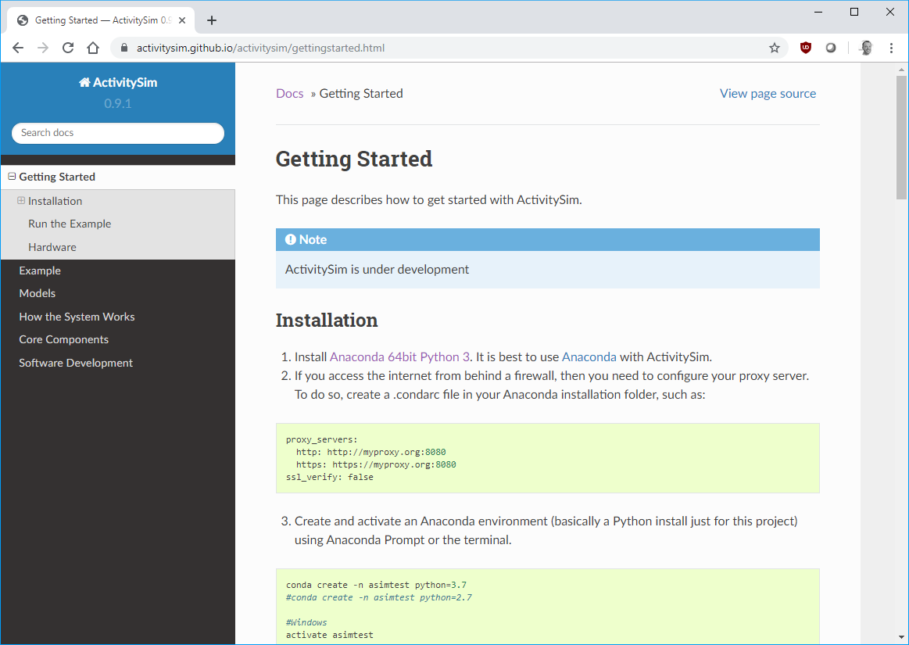
Installing
Get and install Anaconda
64bit Python 2 or 3
  Pre-built collection of performant Python libraries (and underlying C/C++)
Get and install other libraries
  using conda to ensure compatibility and performance
Get and install ActivitySim
  using pip to download the package from the Python Package Index
Notes:
BHARGAV

Slide 15
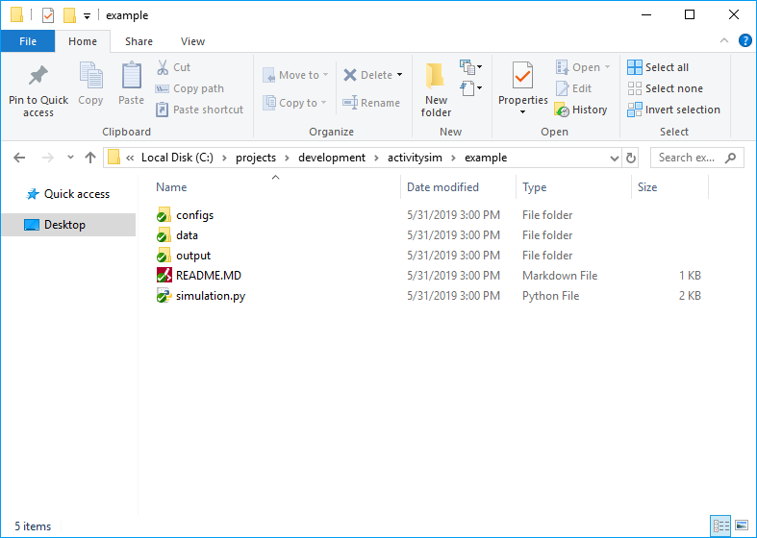
Configuring & Running
Folder and File Setup
  configs - settings, expressions files, etc.
  data - input data such as land use, synthetic population files, and skims
  output - outputs folder
  simulation.py - main script to run the model
Notes:
BHARGAV
SHOW GETTING STARTED WEBSITE LINK
SHOW OVERALL SETUP (BHARGAV)
SHOW HOW AUTO OWNERSHIP MODEL IS SET UP (BHARGAV)
SHOW AUTO OWNERSHIP CLASS
SHOW YAML FILE
SHOW EXPRESSION FILE
SHOW WHERE MADE CHANGES FOR AOC SENSITIVITY TESTS
KICK OFF A 1% RUN (OR MAYBE EARLIER?)

Slide 16
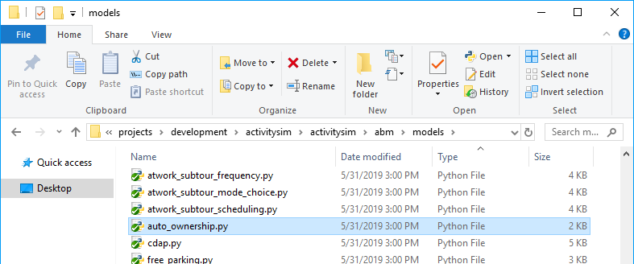
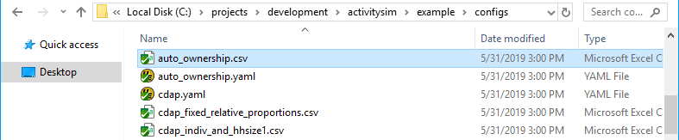
Auto Ownership Model Example
Submodel components:
  Code – auto_ownership.py
  Config – auto_ownership.yaml
  Expressions – auto_ownership.csv
Notes:
BHARGAV
SHOW GETTING STARTED WEBSITE LINK
SHOW OVERALL SETUP (BHARGAV)
SHOW HOW AUTO OWNERSHIP MODEL IS SET UP (BHARGAV)
SHOW AUTO OWNERSHIP CLASS
SHOW YAML FILE
SHOW EXPRESSION FILE
SHOW WHERE MADE CHANGES FOR AOC SENSITIVITY TESTS
KICK OFF A 1% RUN (OR MAYBE EARLIER?)

Slide 17
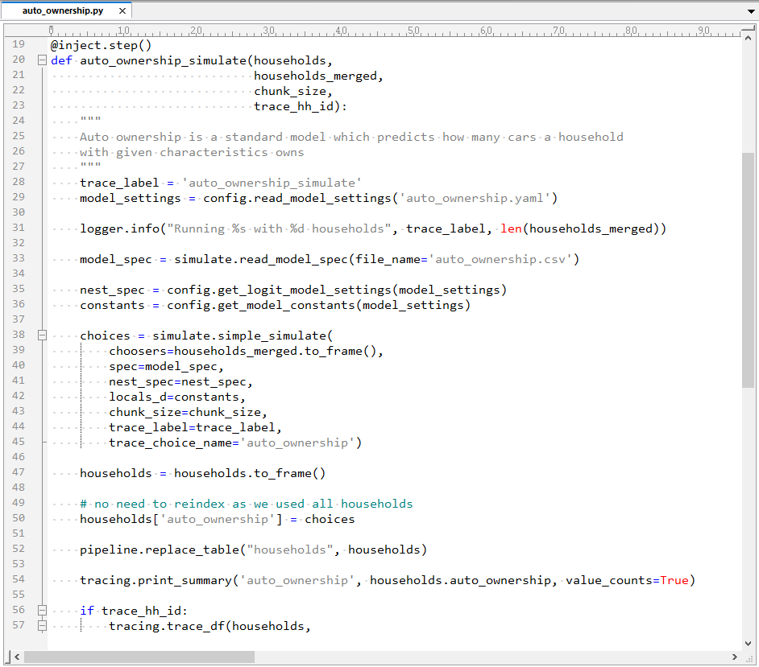
Auto Ownership Model Example
Code:
  @inject_step() = runnable model step
  Takes as input households table
  Reads yaml config file
  Reads model expressions specification
  Makes choices
  Sets households table [“auto_ownership”] column
  Replaces households table in the pipeline
Notes:
BHARGAV
SHOW GETTING STARTED WEBSITE LINK
SHOW OVERALL SETUP (BHARGAV)
SHOW HOW AUTO OWNERSHIP MODEL IS SET UP (BHARGAV)
SHOW AUTO OWNERSHIP CLASS
SHOW YAML FILE
SHOW EXPRESSION FILE
SHOW WHERE MADE CHANGES FOR AOC SENSITIVITY TESTS
KICK OFF A 1% RUN (OR MAYBE EARLIER?)

Slide 18
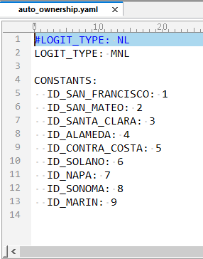
Auto Ownership Model Example
Config:
  Specifies multinomial logit model structure
  Specifies named constants to use the expressions spec
Notes:
BHARGAV
SHOW GETTING STARTED WEBSITE LINK
SHOW OVERALL SETUP (BHARGAV)
SHOW HOW AUTO OWNERSHIP MODEL IS SET UP (BHARGAV)
SHOW AUTO OWNERSHIP CLASS
SHOW YAML FILE
SHOW EXPRESSION FILE
SHOW WHERE MADE CHANGES FOR AOC SENSITIVITY TESTS
KICK OFF A 1% RUN (OR MAYBE EARLIER?)

Slide 19
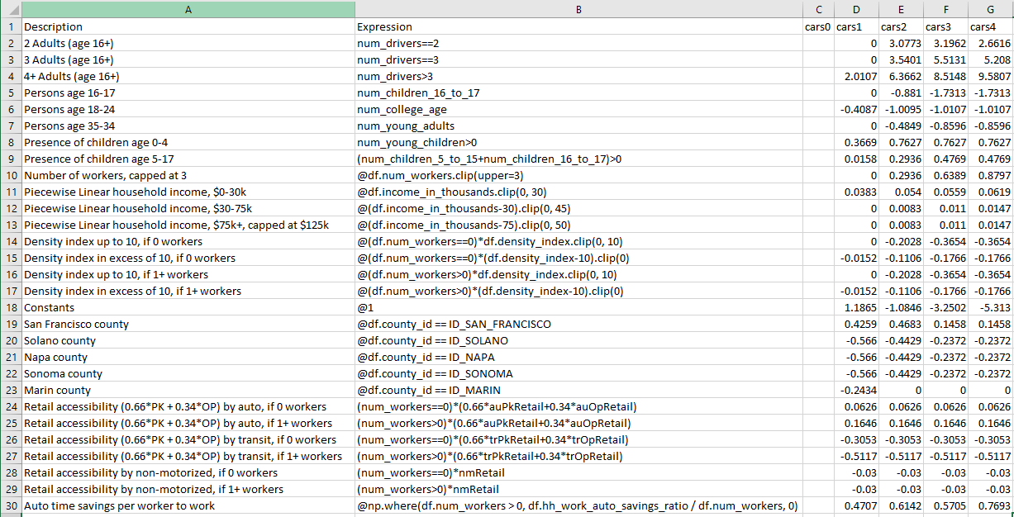
Auto Ownership Model Example
Expressions:
  Utility terms
  Valid Python / pandas / numpy expressions
  Format varies by model type, but is always a structured CSV file
Notes:
BHARGAV
SHOW GETTING STARTED WEBSITE LINK
SHOW OVERALL SETUP (BHARGAV)
SHOW HOW AUTO OWNERSHIP MODEL IS SET UP (BHARGAV)
SHOW AUTO OWNERSHIP CLASS
SHOW YAML FILE
SHOW EXPRESSION FILE
SHOW WHERE MADE CHANGES FOR AOC SENSITIVITY TESTS
KICK OFF A 1% RUN (OR MAYBE EARLIER?)

Slide 20
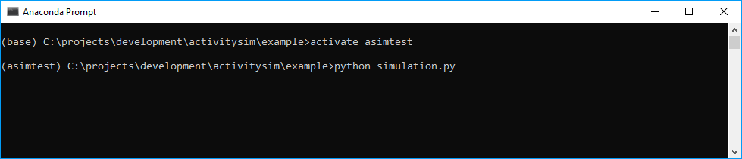
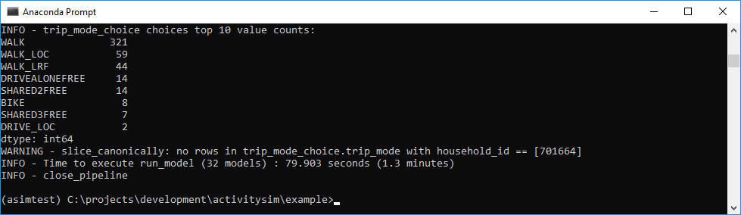
Run Model Example
Run:
  Open Anaconda Prompt
  Change to project directory
  Activate Anaconda environment
  Run simulation.py
Notes:
BHARGAV
SHOW GETTING STARTED WEBSITE LINK
SHOW OVERALL SETUP (BHARGAV)
SHOW HOW AUTO OWNERSHIP MODEL IS SET UP (BHARGAV)
SHOW AUTO OWNERSHIP CLASS
SHOW YAML FILE
SHOW EXPRESSION FILE
SHOW WHERE MADE CHANGES FOR AOC SENSITIVITY TESTS
KICK OFF A 1% RUN (OR MAYBE EARLIER?)

Slide 21
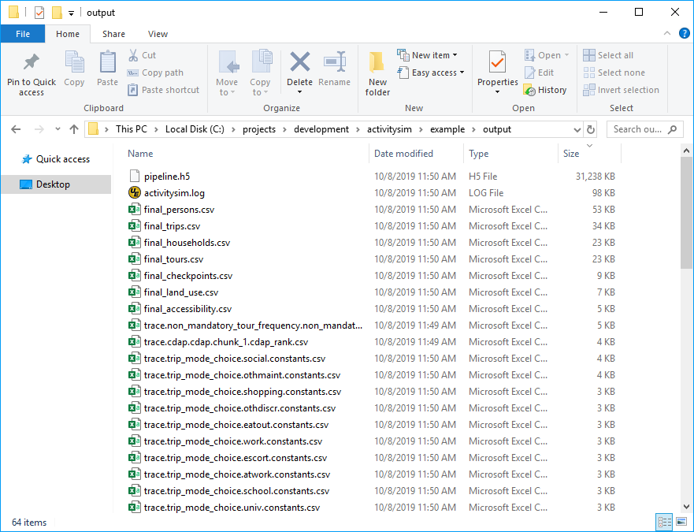
Outputs Example
Pipeline.h5 – all tables before and after each submodel
Final_*.csv – final synthetic travel diary tables
Trace*.csv – tracing of calculations for each model step for debugging
Notes:
BHARGAV
SHOW GETTING STARTED WEBSITE LINK
SHOW OVERALL SETUP (BHARGAV)
SHOW HOW AUTO OWNERSHIP MODEL IS SET UP (BHARGAV)
SHOW AUTO OWNERSHIP CLASS
SHOW YAML FILE
SHOW EXPRESSION FILE
SHOW WHERE MADE CHANGES FOR AOC SENSITIVITY TESTS
KICK OFF A 1% RUN (OR MAYBE EARLIER?)

Slide 22
Verification Results
Notes:
BRICE
SHOW OUTPUT FILES
TRIP LIST
SUMMARY FILES
SHOW TABLEAU AS EXAMPLE OF POST_MODEL SUMMARIES (NEXT SLIDES)
SHOW VISUALIZATIONS OF VERIFICATION

Slide 23
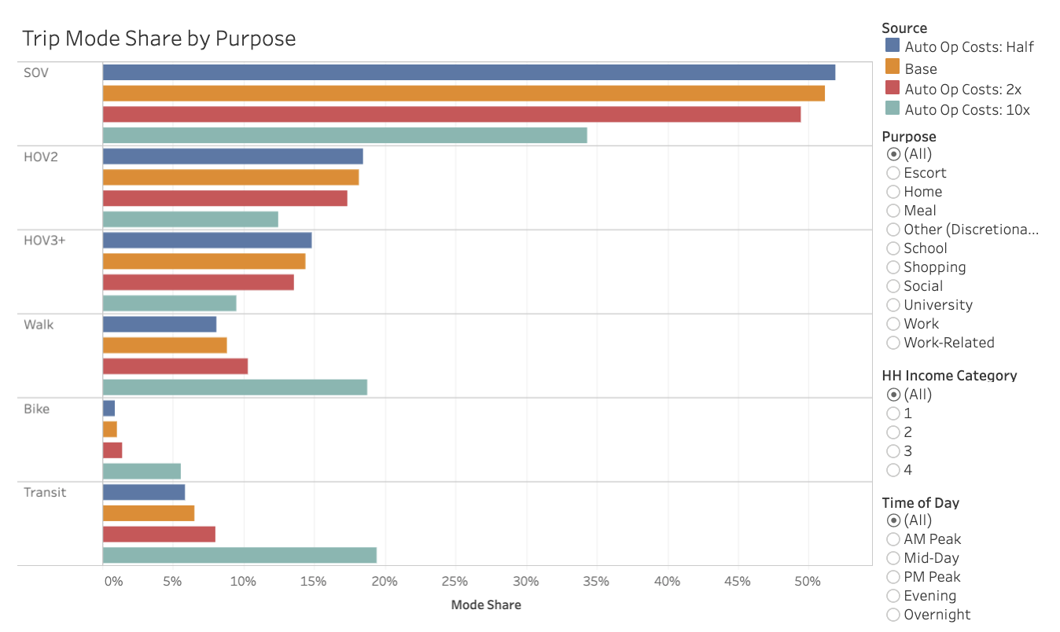
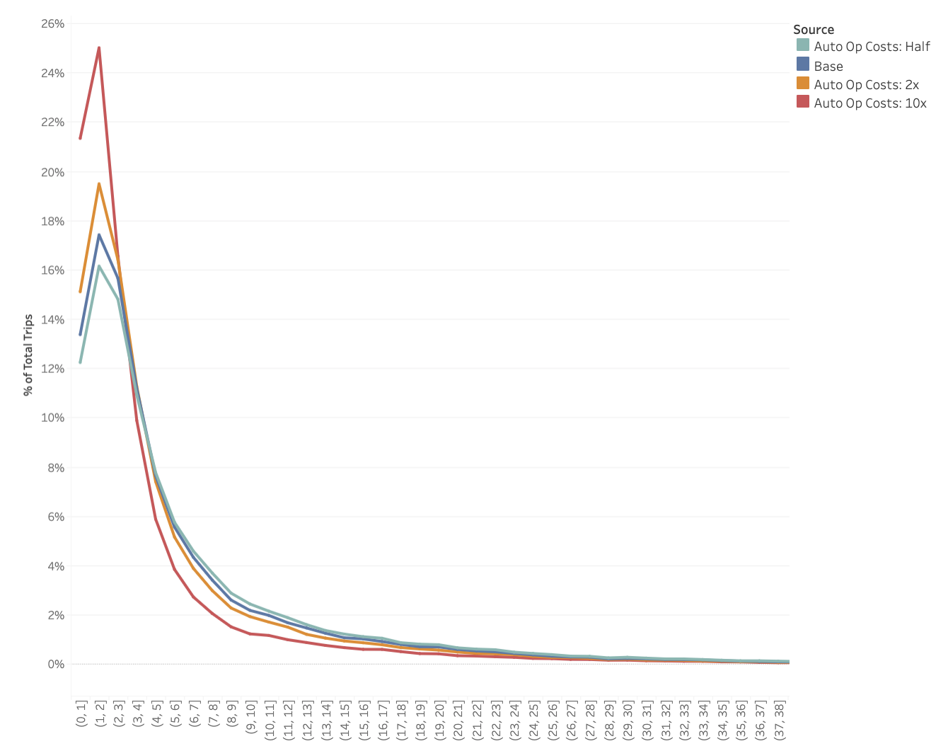
Sensitivity Testing (Auto Operating Cost)
Notes:
BRICE

Slide 24
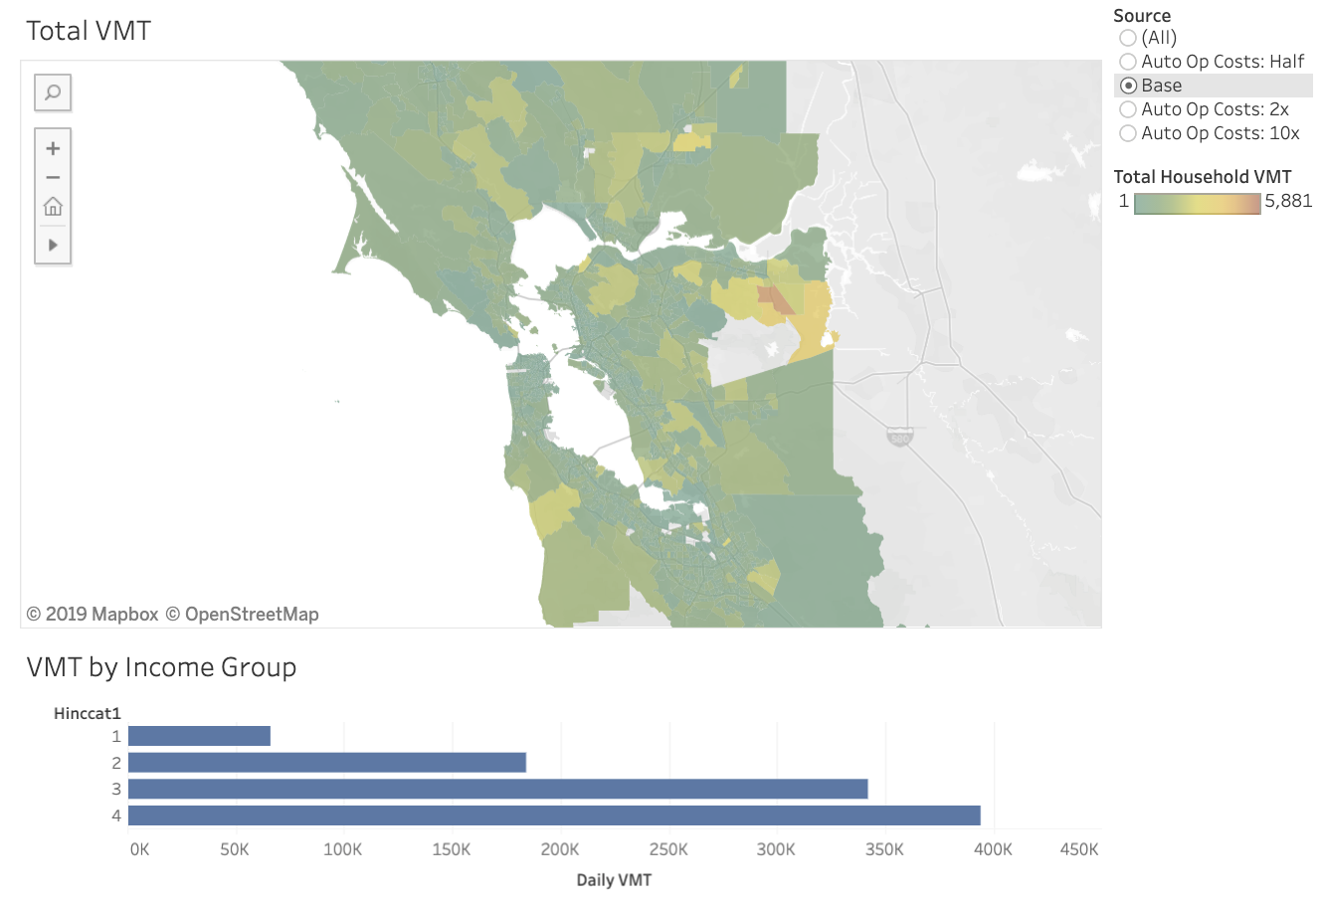
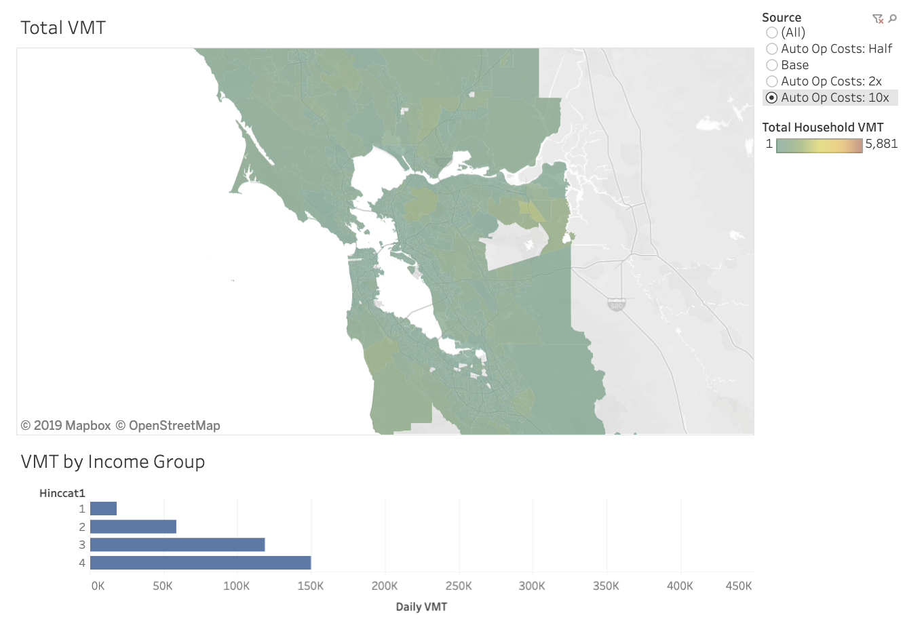
Sensitivity Testing (Auto Operating Cost)
Notes:
BRICE

Slide 25
What’s Next with ActivitySim?
Notes:
JOE

Slide 26
Partner Implementation
ARC
  Implementation underway
SEMCOG
  Implementation begins this fall
MTC
  Implementation of existing model under review
Future implementation (TBD)
  SANDAG
  SFCTA
  PSRC
  Oregon DOT
  Met Council
Notes:
JOE
Mention that MTC, PSRC, and new members ODOT and Met Council are PopSim users. This will be integrated in coming year

Slide 27
Future Development Plans
Partners collaboratively define work scope
  Each year develop one-year scope
  Identify needs and prioritize features
  Phase V (start summer 2019) scoping underway
Phase V draft scope
  Support for multiple zone systems
  TNCs/AVs
  Input validation checking
  Output summarization
  PopulationSim integration
  Performance tuning
Notes:
JOE

Slide 28
Future Development Plans
Develop multi-year scope?
Other potential new features?
  Estimation mode
  Transit virtual path building
  30 minute time periods
  ARC stop time choice model
  Telecommuting
  Transit pass and toll transponder ownership
  Explicit school pickup/dropoff model
Notes:
JOE

Slide 29
Questions?
Bill Keyrouze, AMPO, bkeyrouze@ampo.org
Ben Stabler, RSG, ben.stabler@rsginc.com
Joe Castiglione, SFCTA, joe.castiglione@sfcta.org
Repo
  https://github.com/ActivitySim
Getting Started
  https://activitysim.github.io/activitysim/gettingstarted.html
Notes:
BILL OFFER CONCLUDING THOUGHTS, TEE UP NEXT SESSION

